Slide 1

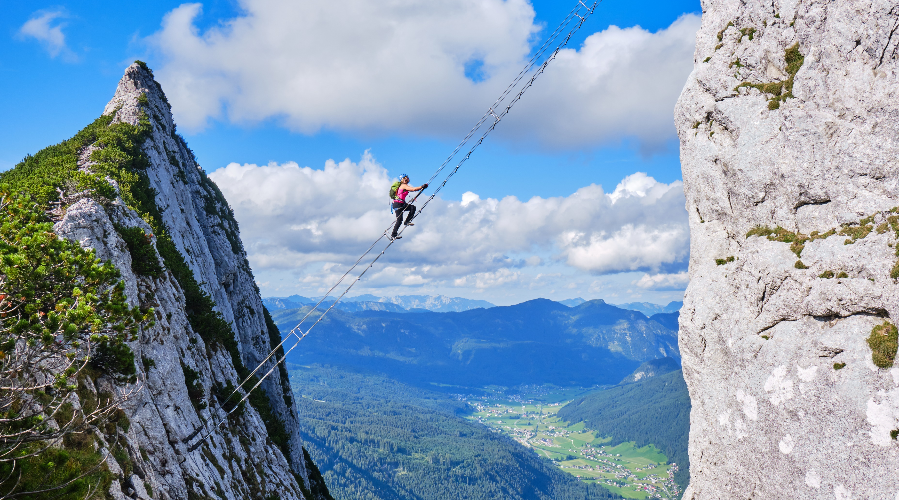
Introduction to K-Nearest Neighbors (KNN)
Michael Deuchert, Huseyn Abdullayev
Notes:
Zum Wechsel des Titelbildes: Bild auswählen > Bildformat (Oben in Menüleiste) > Bild ändern > Neues Bild auswählen

Slide 2
Agenda
Regression model
Classification model

Slide 3
Ask!
Do not hesitate to ask!
If something is not clear, stop me and ask.

Slide 4
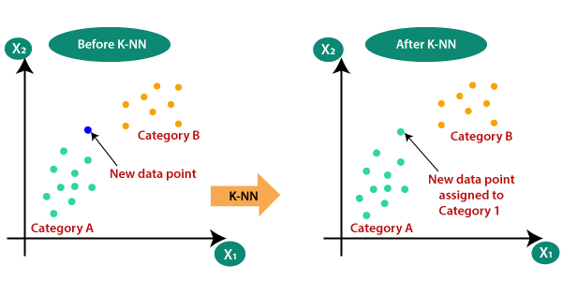
KNN
KNN is one of the simplest machine learning algorithms for classification and regression
It is based on the intuitive idea that similar things exist in close proximity.
Think of it like looking for a restaurant. You'll likely choose a place that's similar to your favorite ones and is nearby.
Source :https://medium.com/swlh/k-nearest-neighbor-ca2593d7a3c4

Slide 5
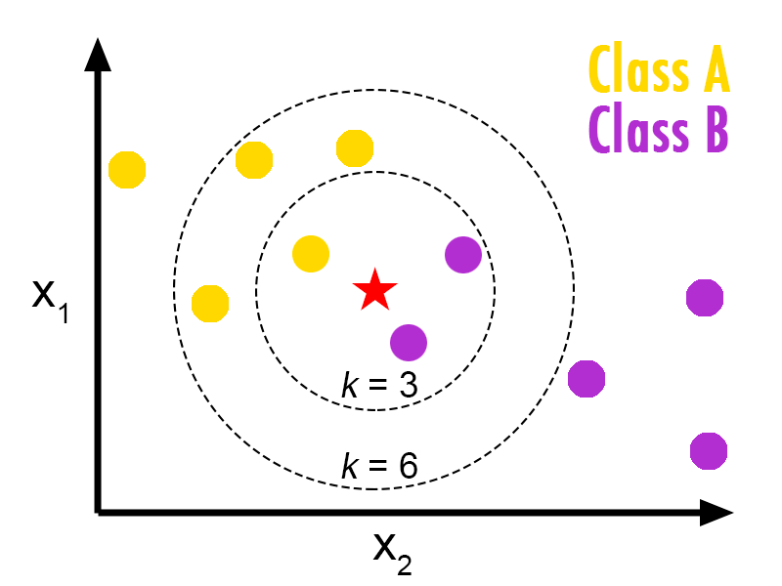
KNN Classification
KNN works by comparing a new, unknown item to the nearest items from a dataset.
The 'K' in KNN stands for the number of neighbors you consider.
For example, if K=3, the algorithm looks at the three nearest neighbors to decide the category of the new item.
When K = 3, the new data point belongs to class A; however, when K = 6, the new data point belongs to class B.
Source :https://medium.com/@bengikoseoglu/why-log-loss-metric-shouldnt-be-used-to-evaluate-nearest-neighbour-classification-1fe314f460a2

Slide 6
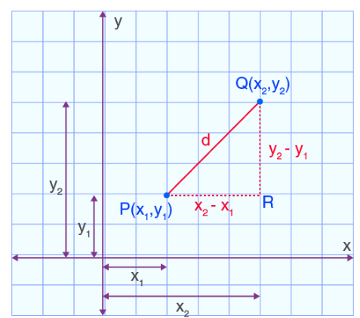
KNN regression
Euclidean Distance:
Distance metrics
Euclidean Distance:
Manhattan Distance
Minkowski Distance
KNN's performance is highly sensitive to the scale of data because distance metrics are influenced by the magnitude of the features.
Different features can have different scales (e.g., height in centimeters and weight in kilograms).
Before applying KNN, it's essential to normalize or standardize the data so that each feature contributes equally to the distance calculations.
Normalization typically means scaling features to a range of [0, 1], while Standardization transforms data to have a mean of 0 and a standard deviation of 1.
Source :https://byjus.com/maths/euclidean-distance/

Slide 7
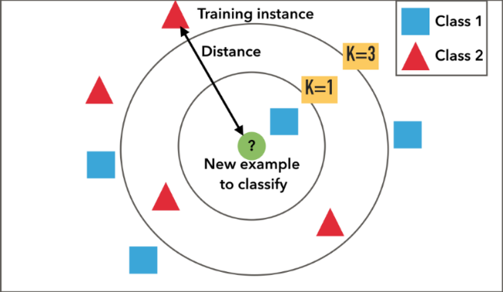
Pros and Cons of KNN
Pros:
Simple and easy to implement.
No need to build a model, tune several parameters, or make additional assumptions.
The algorithm is versatile. It can be used for classification, regression, and search.
Cons:
Computationally expensive because it requires distance calculations for each instance.
Not ideal for large datasets or datasets with many features.
Sensitive to the scale of data and irrelevant features.
Source :https://medium.com/@anuuz.soni/advantages-and-disadvantages-of-knn-ee06599b9336

Slide 8
Delete this slide
Lazy Learning Algorithm: KNN is a non-parametric, instance-based learning algorithm. It's termed 'lazy' because it doesn't learn a discriminative function from the training data but 'memorizes' the dataset instead.
Curse of Dimensionality: KNN suffers from the curse of dimensionality. As the number of features (dimensions) grows, the volume of the feature space increases, and the available data become sparse. This sparsity makes it difficult for KNN to find nearest neighbors in high-dimensional space, as all points are far away from each other.
Distance Metric Sensitivity: KNN's performance is heavily reliant on the choice of the distance metric. Real-world data might not always be linearly separable or uniformly distributed, and certain distance metrics may perform better than others.
Outlier Sensitivity: KNN can be sensitive to outliers, which are data points that significantly differ from other observations. Outliers can skew the results of KNN, as they might be included in the set of K nearest neighbors.
Imbalanced Data: If the dataset is imbalanced (i.e., one class is significantly more frequent than the other), KNN can be biased towards the majority class. Techniques like resampling the dataset or using different weights for the classes can help mitigate this.
Optimal K Selection: The choice of K has a profound impact on the KNN algorithm. A smaller value of K makes the model more prone to overfitting, while a larger K value makes the model more resistant to outliers but may also lead to underfitting.
Feature Relevance: KNN assumes that all features are equally important, which is not always the case. Feature selection or dimensionality reduction techniques like PCA (Principal Component Analysis) can be crucial for improving KNN's performance.
Data Preprocessing: Due to its reliance on distance calculations, preprocessing steps like feature scaling (normalization or standardization) and dealing with missing values are vital to ensure that KNN performs optimally.
Ensemble Methods: To improve the predictive performance and robustness of KNN, it can be used as a part of ensemble methods, like bagging and boosting, which combine the predictions of multiple KNN models.
Local vs. Global Model: KNN inherently acts as a local model, as predictions are entirely based on the nearest neighbors of each query point. This local nature allows KNN to capture complex decision boundaries that global models might miss.

Slide 9



